Slide 1

README
This documents gives you some examples to describe how your application informs end users and how the data flows across all actors.
You have two choices :
1. Send us your existing document if you already have one
2. Create a new one by getting inspiration from this document

Slide 2
Data journey
Indicate actors involved in processing the data as well as the geography in which they are located.

Slide 3

Data Lifecycle Diagram (example 1)
Orange
Analyzed item
Third-party app
Europe <country here>
Number Verification API request
My app payload
MyApp
Aggregator
France
End user
MyApp response
Number verification via API performed by my company
API response
Outside the European Union
Orange
Aggregator

Slide 4
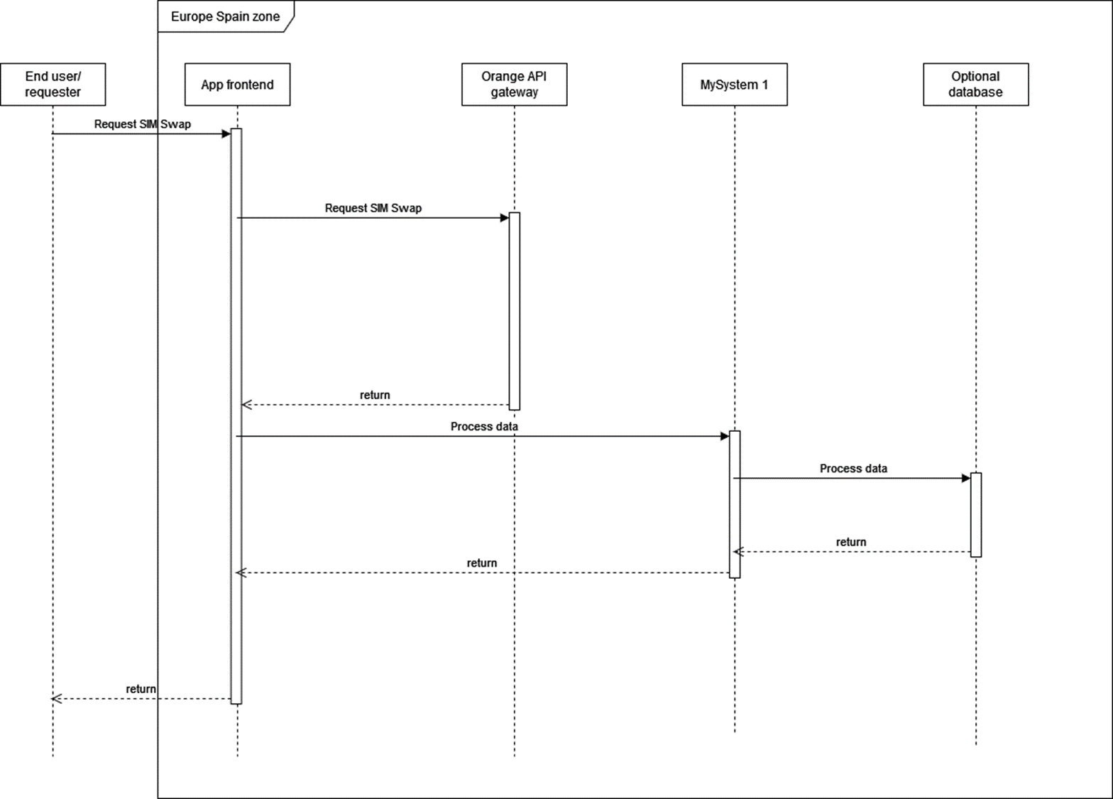
Data Lifecycle Diagram (example 2)

Slide 5
App screenshots
Display how the user is informed prior to the data processing

Slide 6
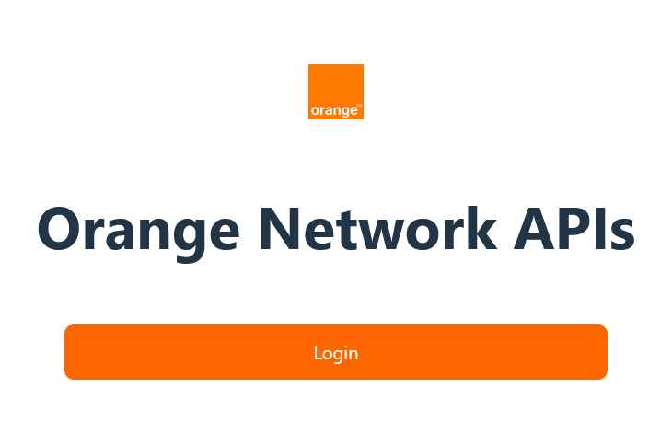
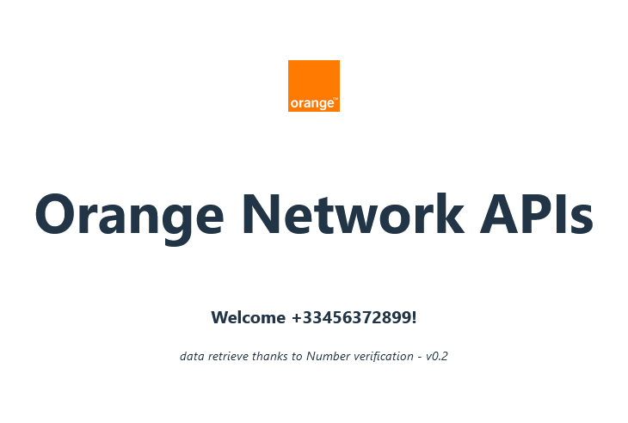
Screenshots of the application (example)

Slide 7
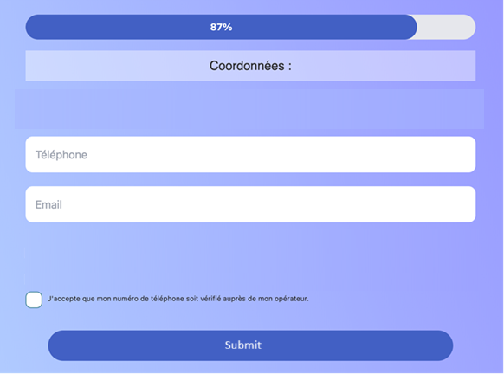
Screenshots of the application (example)

